Slide 1





HIDDEN HEALTH RISKS IN
STARBUCKS BEVERAGES
DAKSHA GUMMADI
DATA STORYTELLING PROJECT

Slide 2
WHAT QUESTIONS ARE WE ASKING?
Which drink categories contain the most sugar and calories?
How do drink sizes affect nutrition content?
Are there hidden nutritional “surprises” in seemingly healthy drinks?
What patterns emerge when comparing drink types?
Can we identify which drinks to avoid if watching sugar intake?
Exploration Method: I analyzed Starbucks drinks across 9 beverage categories assessing calories, sugar content (gm) and caffeine levels

Slide 3

WHAT I FOUND BY THE NUMBERS
193
33g
510
84g
Average Calories
per Drink
Average Sugar
That’s about
8 tsp!
Max Calories
White Chocolate
Mocha
Java Chip
Frappuccino

Slide 4
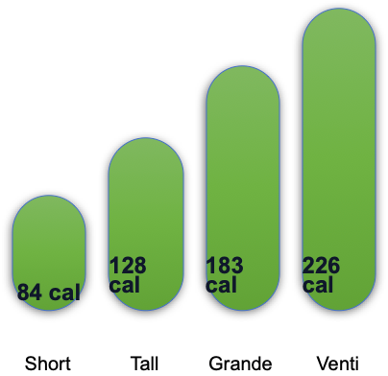
INSIGHT #1: SIZE MATTERS (A LOT!)
Finding: Moving from Short to Venti nearly triples the calorie content. A venti has nearly 170% more calories than a Short

Slide 5
INSIGHT #2: SOME CATEGORIES ARE SUGAR BOMBS
*Daily recommended sugar for adults is 25-36 grams.
A single venti Frappucino can exceed your daily limit

Slide 6
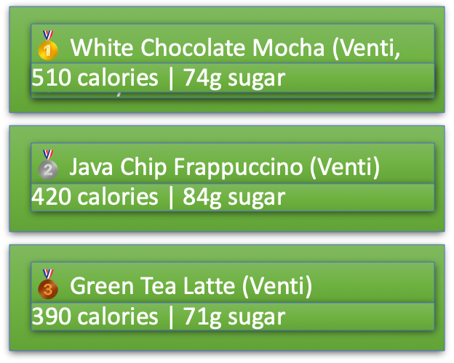
INSIGHT #3: THE HIGHEST CALORIE DRINK
Key Finding: Frappuccinos and specialty mochas dominate the highest calorie list. These drinks often contain as much sugar as 2-3 candy bars.

Slide 7


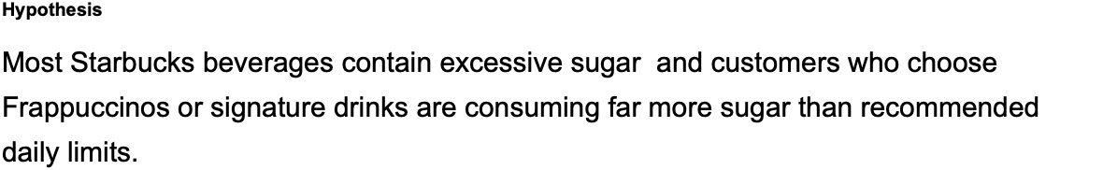
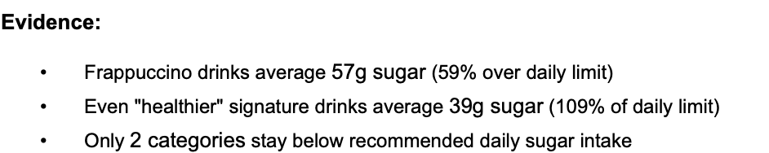
MY HYPOTHESIS

Slide 8
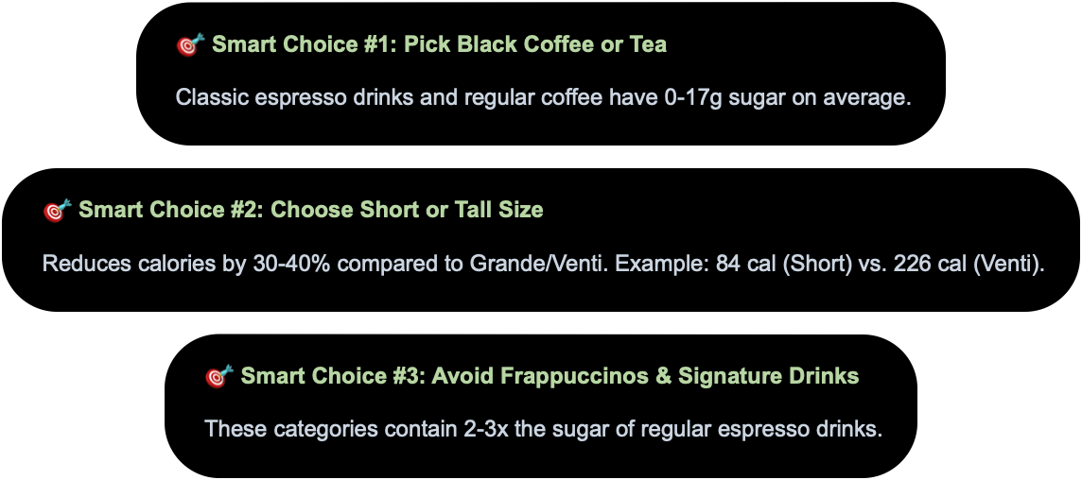
KEY TAKEAWAYS & RECOMMENDATIONS

Slide 9



QUESTIONS
What Drink Will You Order Next?

